Slide 1

Machine Learning Modeling in Predicting Coronavirus Case Count Using Health Literacy
Akhilesh Akula
Nachammai Palaniappan
Nithin Reddy Malyala

Slide 2



Akhilesh Akula
Nachammai Palaniappan
Nithin Reddy Malyala

Slide 3
Problem Statement
Health literacy is instrumental in prevention of communicable diseases, but is the same true for non-communicable diseases such as COVID-19

Slide 4

Health Literacy
Obtain, read, understand, and use healthcare information in order to make appropriate health decisions and follow instructions for treatment
Strong health literacy enables people to develop the skills and confidence to make informed decisions about their health and the health of their families
This is avidly researched for non-communicable diseases, but not so much for communicable diseaes

Slide 5
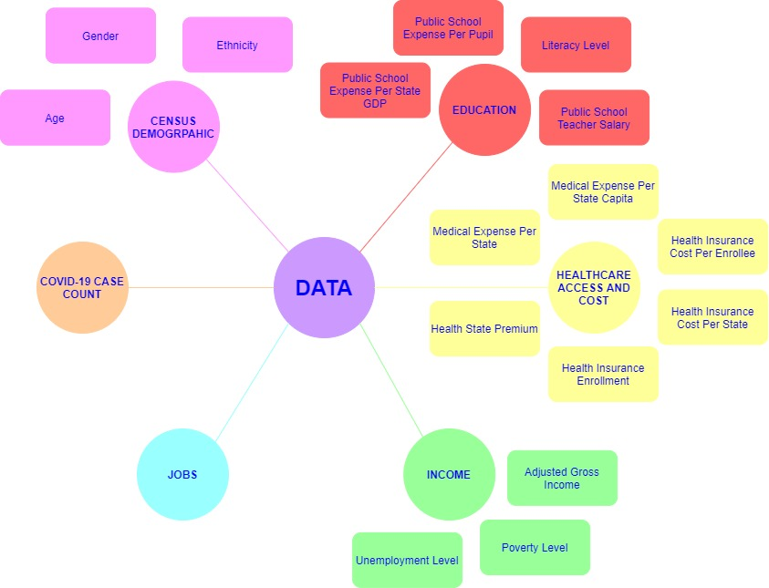
Data

Slide 6
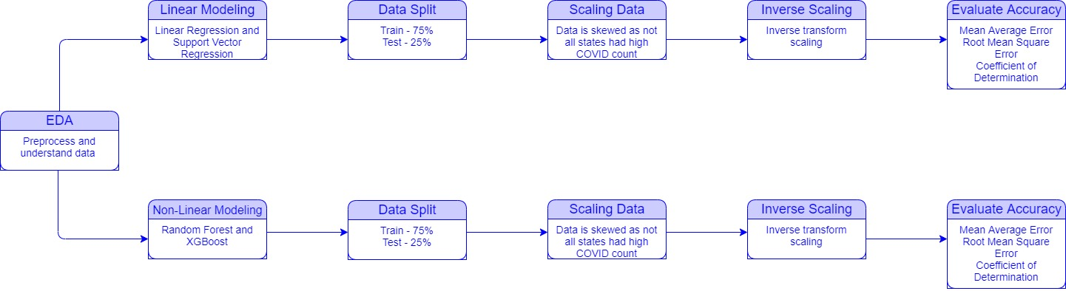
Method

Slide 7
Linear Models
Linear Regression
Support Vector Machines
Analyzes the linear relationship between a dependent variable with given set of independent variables
Value of one or more independent variables will change (increase or decrease), the value of the dependent variable will also change accordingly (increase or decrease)
Powerful yet flexible supervised machine learning algorithms which are used both for classification and regression
Representation of different classes in a hyperplane in multidimensional space
Goal of SVM is to divide the datasets into classes to find a Maximum Marginal Hyperplane

Slide 8
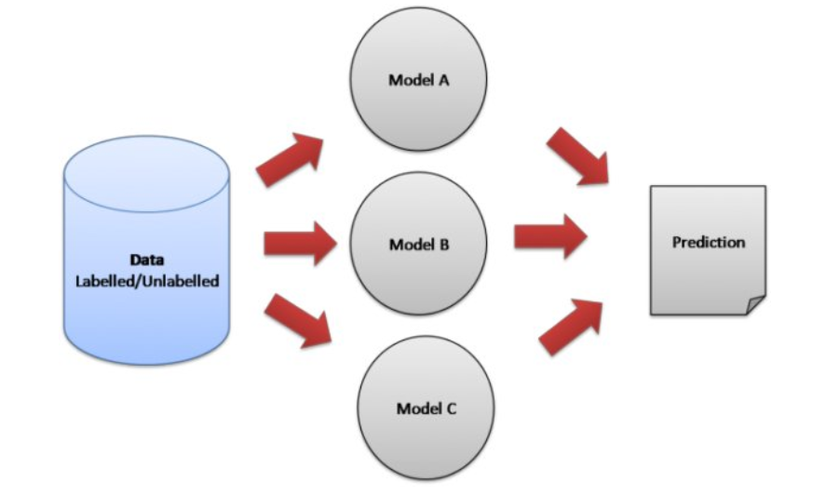
Ensemble Models
Ensemble methods help improve machine learning results by combining multiple models
Steps:
Number of base learners are created
Combined with majority voting, for classification, or weighted averaging, for regression
Bagging:
Meta-algorithm combining predictions from multiple decision trees through a voting mechanism
Boosting:
Models build sequentially by minimizing the errors from previous models

Slide 9
Ensemble Models
Random Forest
XGBoost
Operates by constructing a multitude of decision trees at training time and outputting the class that is the mode of classes (Classification) or mean prediction (Regression)
Process:
Start with selection of random samples
Construct decision tree for every sample
Vote on predicted result
Select the most voted prediction result
Operates use of gradient boosting framework
Process:
Similar to Random Forest, XGBoost produces multiple models but optimizes the algorithm through parallel processing and minimizes errors in each model produced

Slide 10
Overall Results
Data Group | Machine Learning Model | Mean Average Error | Root Mean Square Error | Coefficient of Determination
Overall | XGBoost | 11787.82836 | 24526.67889 | 0.89839
Census Demographic | Random Forest | 16069.29548 | 29682.19636 | 0.85118
Education Level | Random Forest | 13529.27597 | 18536.16600 | 0.94196
Healthcare Access and Cost | XGBoost | 12625.24015 | 18661.73958 | 0.94117
Income | Random Forest | 14504.23545 | 20044.31515 | 0.93213
Jobs | Support Vector Regression | 21331.56395 | 30853.96169 | 0.83920

Slide 11
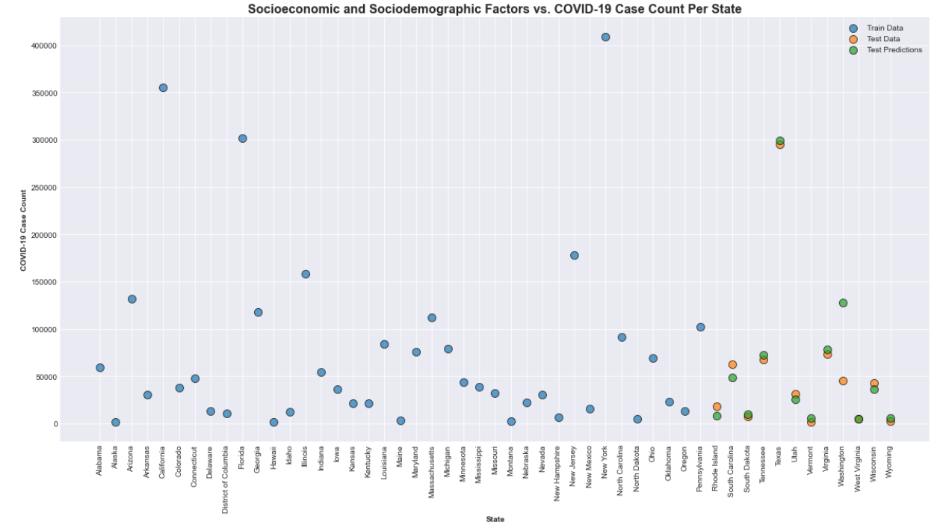
Overall Results

Slide 12
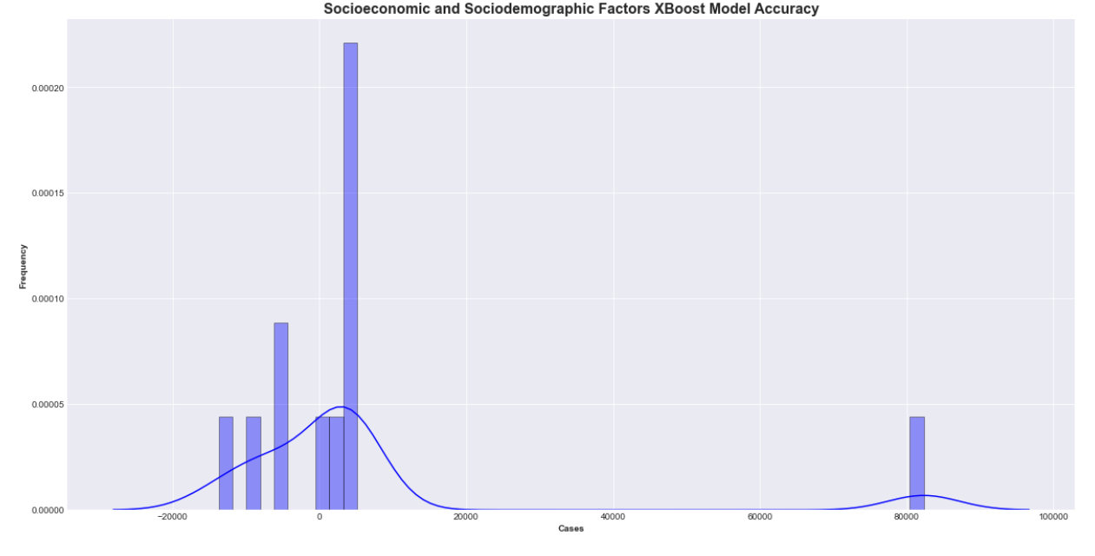
Overall Results

Slide 13
Subcategory Results
Data Group | Subcategory Data Group | Machine Learning Model | Mean Average Error | Root Mean Square Error | Coefficient of Determination
Census Demographic | Ethnicity | Support Vector Regression | 9514.07663 | 13046.70112 | 0.97124
Education Level | Expense Per Pupil | Linear Regression | 11479.15162 | 13971.90993 | 0.96702
Healthcare Access and Cost | Health Expense Per State | Support Vector Regression | 9903.739896 | 12506.67990 | 0.97358
Income | Poverty | Support Vector Regression | 8094.278109 | 10369.776720 | 0.98183
Jobs |  | Support Vector Regression | 21331.56395 | 30853.96169 | 0.83920

Slide 14
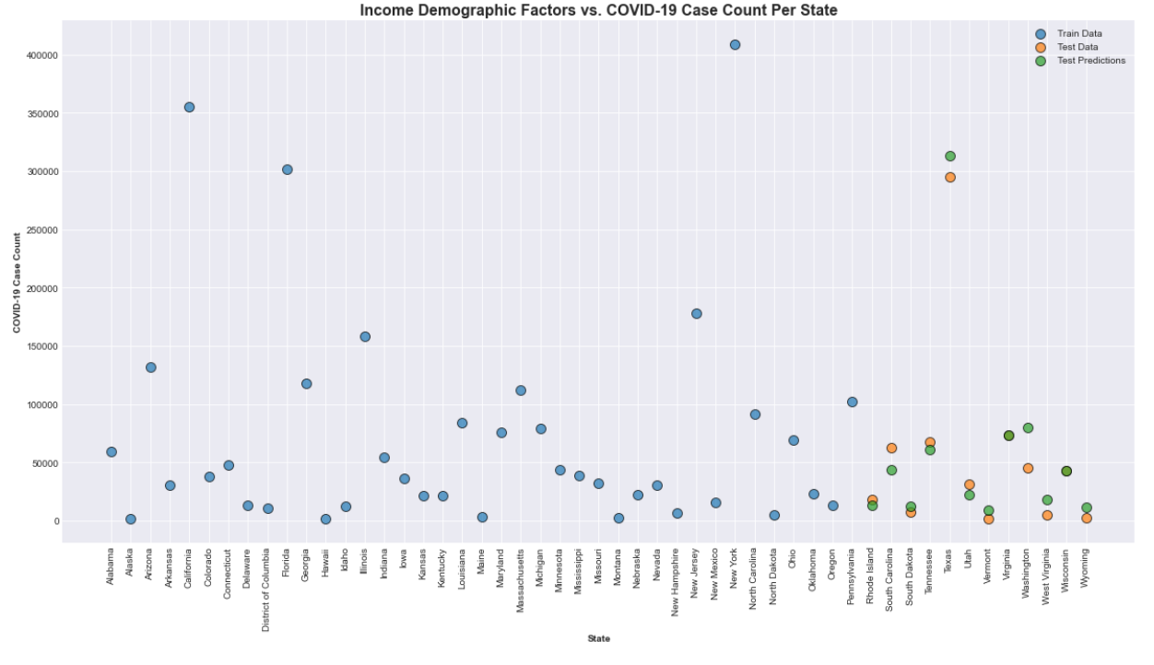
Income Results

Slide 15
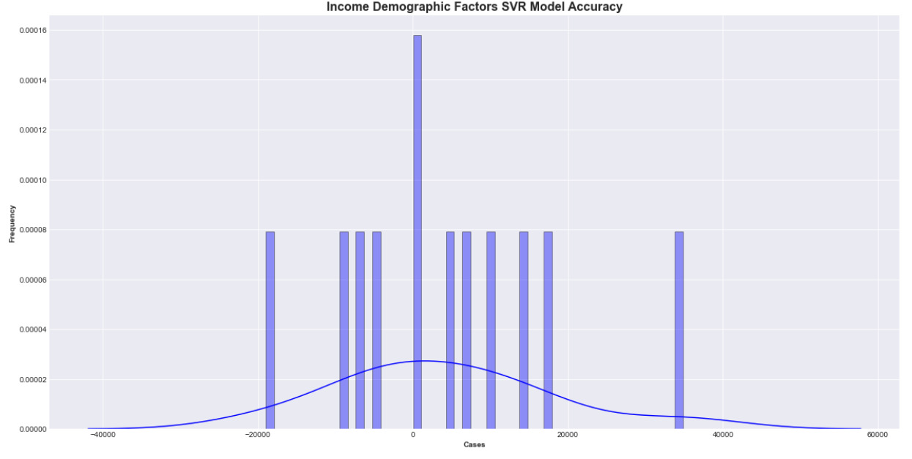
Income Results

Slide 16
Limitations
Health literacy is not defined and not enough research of its effect on communicable diseases
Feature importance and selection cannot be completed
Sample size of 51 states, train size of 39, and test of 12
Better to use counties in the future

Slide 17
Take Away
Healthcare Policy Challenges
Model application to help state governments enforce and effectively communicate information regarding combating communicable disease
Healthcare Cost
Private investment in US healthcare has grown, primarily in Radiology, ER Physicians, Hospitals, and Anesthesiologists
Model application to predict states where investments have a high ROI
Health Literacy
Beneficial for non-communicable diseases such as COVID, just as beneficial for communicable diseases

Slide 18
Thank You!

Slide 19
Questions?

